Slide 1
Chapter 3 Spatial Datatypes
Presented by Chris Dant

Slide 2
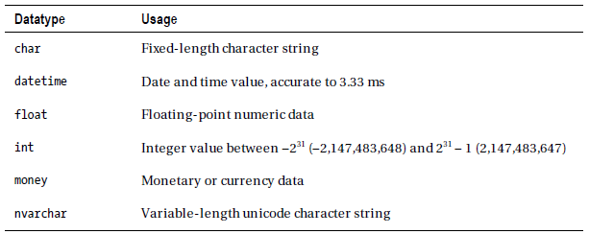
SQL Datatypes
All attributes must have a datatype, so SQL added new ones for spatial data
Two spatial datatypes:
geography is for geodetic data
geometry is for data on an arbitrary plane
Common SQL datatypes
Spatial SQL datatypes

Slide 3
Similarities
They both employ a vector model of spatial data (features may be represented using a range of geometries including Points, LineStrings, Polygons, and collections of these types)
Internally stored in the same format
Use object-oriented methods based on the .NET framework
Both provide much of the same standard spatial functionality (such as calculating the length or area of a feature, the distance between features, or testing whether two features intersect)
Essentially, they are used the same way but apply to different data

Slide 4
SQLCLR
Both spatial datatypes are CLR (Common Language Runtime) datatypes
They use the same environment used to execute managed .NET code
When using CLR datatypes, SQLCLR is used instead of T-SQL (Transact-SQL)
Using that environment allows SQL to deal with complex datatypes more efficiently
Unlike user-defined CLR datatypes, no extra configuration is required (yay!)
There are some special considerations, however:

Slide 5
Special Considerations with CLR
Each CLR data item is defined as an object, so if you do a simple SELECT on them, your query will return a set of binary values
As with classes in object-oriented languages, a CLR datatype defines a number of methods and properties
Each individual item of geography or geometry data is an instance of the respective datatype, and inherits the methods of the datatype from which it is derived
Methods defined by the geometry datatype can only be used on items of geometry data, and methods defined by the geography datatype can only be used on items of geography data.
The syntax for SQLCLR is different from T-SQL

Slide 6
Special Considerations with CLR
Unlike with T-SQL functions, methods and properties for CLR are case sensitive
CLR datatypes can be used within the .NET application layer as well as within SQLCLR, so if you design well you can reuse some routines
Errors need to be handled differently than with T-SQL
Because spatial data are not comparable, you can't use geometry or geography data with any T-SQL operators that make a direct comparison between two values
This includes ORDER BY, SELECT DISTINCT, UNION, and typical join syntax
Must instead use comparison operators defined by the datatype itself

Slide 7
Methods and Properties
The methods available for an item of data depends on its datatype
In most cases there are equivalent methods for geographies and geometries, but some are completely exclusive
Some have same functionality but different name. For example:
Lat and Long return coordinate data from a geography
STY and STX return the coordinate data from a geometry
Two primary classifications of methods available, OGC methods and extended methods

Slide 8
OGC Methods
These methods adhere to the Open Geospatial Consortium specifications and are prefixed by the letters ST (an abbreviation for spatiotemporal)
These methods provide commonly used, basic functionality for working with spatial instances such as:
STIntersects(), used to determine whether one instance intersects another
STDistance(), used to calculate the shortest distance between two instances
STArea(), used to calculate the area contained within a Polygon instance.

Slide 9
Extended Methods
SQL Server provides a number of extended methods, which provide additional functionality on top of the OGC standard. These include:
Reduce(), which simplifies a geometry
BufferWithTolerance(), which applies a buffer within a given tolerance limit
Filter(), which performs an approximate test of intersection based on a spatial index

Slide 10
Static Methods
To create an item of spatial data, you must use a static method belonging to the corresponding datatype
The syntax for static methods is Datatype::Method(param)
Example: Parse
Creates an instance from a Well-Known Text string
SELECT geometry::Parse(‘Point(30 40)’);
The geometry Parse method treats all supplied coordinate values as defined using SRID 0; that is, they are abstract coordinates with no relation to a specific model of the Earth

Slide 11
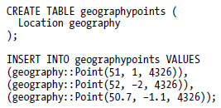
Static Methods
Example: CREATE TABLE and INSERT INTO
Creates a spatial table and then inserts data into it
The geographypoints table now contains three rows each representing a location in the south of England, defined using the EPSG:4326 spatial reference system

Slide 12
Instance Methods
Operations performed on individual values of spatial data are called instance methods
Common calculations include intersections, measuring distances, and addition and subtraction of geometries
Syntax is Item.Method(param)
Example: ToString
Retrieves the Well-Known Text representation of any spatial item

Slide 13
Instance Methods
Example: STBuffer
Creates a buffer zone around a geometry
The example code listing declares a geometry Point variable located at (12 7) using the geometry Point() static method, and then selects a buffer of 5 units about that geometry by calling the STBuffer() method on that instance
Instance methods can be chained together:

Slide 14
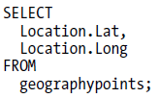
Properties
Certain properties of spatial objects can be accessed directly
Syntax is Item.Property
Example: Lat and Long
Some properties, such as Lat and Long are read-only
Changing the coordinate values associated with a spatial instance requires you to make a whole new instance

Slide 15
Properties
Some properties of spatial objects can be updated
Example: STSrid update
Changes the spatial reference identifier of the Points in the geographypoints table to use the North American Datum 1983 (SRID 4269)

Slide 16
Spatial Libraries
All of the functionality for the geometry and geography datatypes are stored in two libraries:
Microsoft.SqlServer.Types.dll defines the spatial datatypes
SqlServerSpatial.dll provides spatial operations
These libraries are installed with SQL Server, but are also available separately
They can be used in any .NET language the same way, even without SQL Server installed
Almost all examples from the book are in terms of SQL queries, but can be converted to work in any .NET language

Slide 17
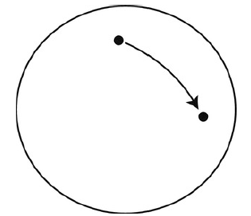
The geography Datatype
The defining characteristic of the geography datatype is obviously that it stores geodetic data, or data that takes into account the curve of the earth
To do this, geography data is always stated in terms of angular coordinates of latitude and longitude from a geographic coordinate system
When geography data is queried, SQL Server uses angular calculations to produce the result

Slide 18
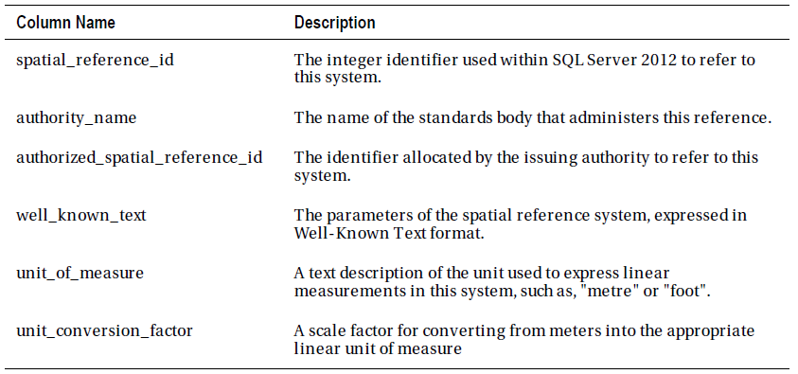
Spatial Reference Systems for the geography Datatype
Use of geography data requires a reference system supported by SQL Server to work off of. The list of supported systems is found in the sys.spatial_reference_systems table. The table has the following structure:

Slide 19
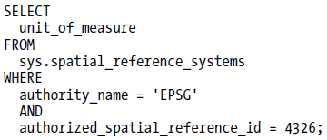
Spatial Reference Systems for the geography Datatype
The parameters that describe a geographic coordinate system are stored in WKT format in the well_known_text column of the table
Reference systems have a unit of measure built in, often degrees, but the table has another column for unit of measure. This unit of measure is used for measuring distances and areas that cannot be expressed in degrees.
The following query can be used to check what unit a reference system uses:

Slide 20
Spatial Reference Systems for the geography Datatype
Checking the unit is useful, because other spatial queries do not return units, so we need to check to understand our data
For example, the following query returns the distance between Paris and Berlin:
It returns this result:

Slide 21
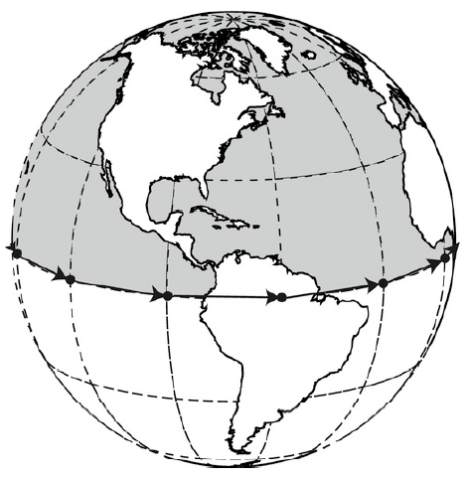
Correct Ring Orientation for geography Polygons
A ring is a closed (looped) LineString, and Polygons are made of one or more rings
Ring orientation refers to the direction, or order, in which the points that represent a polygon are listed
The geodetic model of the earth is a continuous round surface, and therefore has no edges
Without edges, how do you define what area a polygon ring encloses?

Slide 22
Correct Ring Orientation for geography Polygons
To deal with this ambiguity, SQL Server uses the “left-hand rule”
If you imagine yourself walking along the ring of a geography Polygon, following the points in the order they are listed, SQL Server treats the area to the left as the interior and the area to the right as the exterior
Another way of thinking about this is to imagine looking down at a point on the surface of the Earth from space; if that point is enclosed by a Polygon ring in a counterclockwise direction then that point is contained inside the Polygon, otherwise it is outside

Slide 23
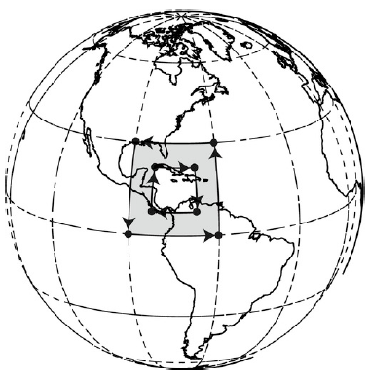
Correct Ring Orientation for geography Polygons
Polygons can also contain interior rings which mark out areas not included in the polygon
To define an area of space not included in a Polygon you should therefore enclose it in a ring of Points listed in clockwise order, so that the area to be excluded lies to the right of the line
The geography datatype has a ReorientObject() method, which flips the interior and exterior of a geography Polygon instance, and has the same effect as reversing the coordinate order of each ring

Slide 24
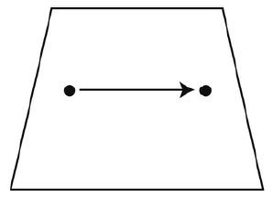
The geometry Datatype
The geometry datatype operates on a 2D flat plane
Calculations such as distance are worked out using simple geometrical methods
Stores data using the Cartesian (x,y) coordinate system
This makes it ideal for storing coordinate data from a projected spatial reference system
It can also be used to store “unprojected” coordinates, where longitude is mapped onto the x-axis and latitude onto the y-axis (this is an implicit projection)

Slide 25
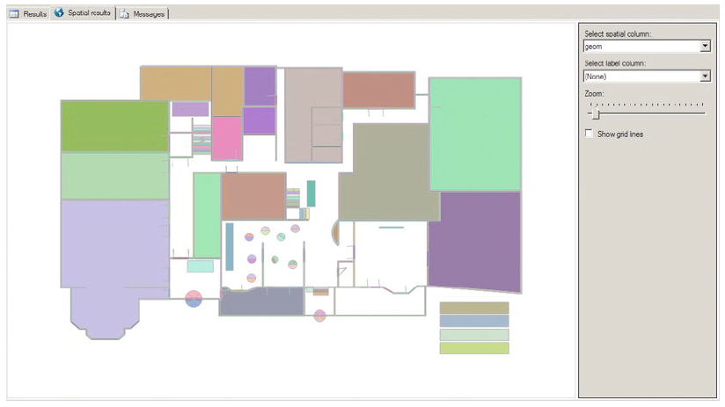
The geometry Datatype
Can be used to express any x-y coordinate data
Data from a local survey
Topological plans of a small enough area that curvature of the earth can be safely ignored
Geometrical data obtained from CAD packages

Slide 26
The geometry Datatype
Because the geometry type uses simple planar calculations, the results of calculations is expressed in the same units the underlying data is stored in
Most projected systems are expressed in terms of meters
In contrast, the floorplan shown earlier was measured in pixels
The geometry type affords complete freedom of units: the unit that goes into a calculation is always what comes out

Slide 27
Spatial Reference Systems for the geometry Datatype
The geometry datatype does not rely on knowledge of the unit of measurement in which coordinates are defined; therefore stating a different SRID does not alter the numeric value of any calculations performed on geometry data
In chapter 1, it said all coordinates must be stated with an SRID, so what gives?
The initial projection is calculated using a reference system, but thereafter is already in x-y coordinate form so changing reference system has no effect on the result of calculations
However, you should still provide the appropriate SRID, as it is used to interpret data and give it meaning
Once you lose metadata like the SRID, it is difficult or impossible to get it back

Slide 28
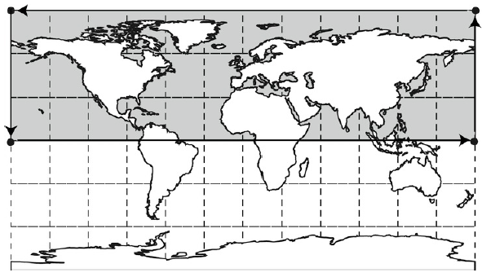
Unambiguous Polygons

Slide 29
Comparing geography and geometry Datatypes
The most important factor is obviously whether your application requires geodetic data or planar data
Other factors to consider are:
Consistency
Accuracy
The End(s) of the World
Presentation
Performance
OGC Standards Compliance

Slide 30
Consistency
In order to perform various operations, all data must be defined using the same spatial reference system and must be of the same type
It is not possible to combine geometry and geography data in a query, nor perform operations on the same datatype using different SRIDs; attempting these returns null
Since all data must match, if you have existing data you wish to use, everything else must match that format

Slide 31
Accuracy
Because the geometry data uses a flat plane and all geospatial features are therefore projected, geometry data will always contain distortion
Calculations using distorted data unsurprisingly results in distorted results
Whether you should use the geometry datatype depends on your need for accuracy and the size of the area you’re projecting
Geography has no distortion and is best when high degrees of accuracy are required

Slide 32
The End(s) of the World
Flat projections have edges that must be accounted for when performing calculations
Typically, this becomes an issue when
any geometries or calculations cross the 180th meridian (horizontal split on most maps)
any Polygon encloses the North or South Pole

Slide 33
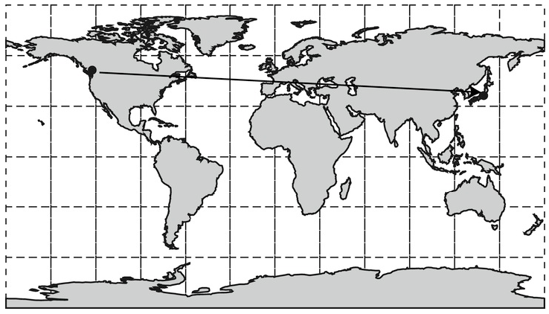
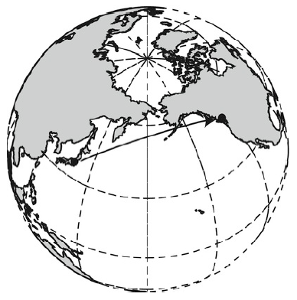
The End(s) of the World

Slide 34
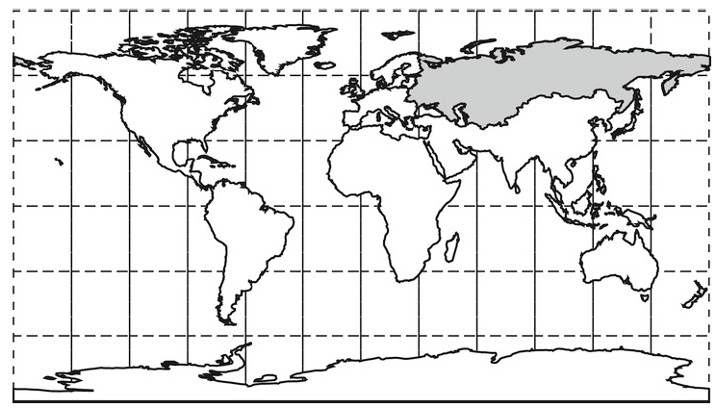
The End(s) of the World

Slide 35
Presentation
Because the geography type uses a 3D model of the Earth, if you want to present the results of some query in a display, it must be projected to 2D and therefore distorted
The geometry type uses 2D coordinates and can be displayed immediately without any additional calculations
Since data must be projected anyway, you should consider storing it that way if practical to reduce query and display times

Slide 36
Performance
On a note related to presentation, performance of calculations is dependent on what datatype is used
The ellipsoidal calculations required for geography data are much slower than Cartesian calculations for geometry data
This further supports projecting your data and keeping it that way in the database if you will project the data anyway or accuracy is not an issue

Slide 37
OGC Standards Compliance
The Open Geospatial Consortium (OGC) administer a number of industrywide standards for geospatial data
The geometry datatype conforms to the OGC Simple Features for SQL specifications v1.1.0 and implements all methods required to meet that standard
The geography datatype implements many of the same methods but does not completely conform to the OGC standards
Therefore, if OGC compliance is important you should use the geometry datatype

Slide 38
General Rules
For general use, many of these considerations don’t mean much
These general rules help make practical decisions for common use:
If you have latitude and longitude coordinate data (collected from a GPS, from Google Earth, or most sources listed on the Web) use the geography datatype, normally using the default 4326 SRID.
If you have x- and y-coordinate data (e.g., collected from a flat map), use the geometry datatype with an SRID to represent the map projection and datum used.
If you have x- and y-coordinate data that are not defined in relation to any particular model of the Earth, use the geometry datatype with SRID = 0.

Slide 39
Storage Requirements
Both the geometry and geography datatypes are of a variable length, like varchar
The size depends on the complexity of the data to be stored, so a point is small and a complex polygon is large
The structure of a geometry or geography begins with a 6-byte header followed by a binary stream of a variable number of 8-byte points
There is no specific maximum size, although SQL Server has an implicit maximum size of ~2GB

Slide 40
Internal Data Structure
Generally you don’t need to know the internal format SQL Server uses to store spatial datatypes
It can be useful to modify the bytes of a spatial instance directly if you’re using unmanaged C/C++ code, etc
If you are using unmanaged code, there is a lovely tutorial on pg. 72 of the textbook
Nathaniel will cover this more in depth in the next chapter

Slide 41
Converting Between Datatypes
Although their physical representation are the same, you cannot convert directly between spatial datatypes using CAST or CONVERT; you will get an error
There are few scenarios where this makes sense to do, but there are a few (wanting to use a method only available to the geometry for example)
To convert between them, we use the fact that both can be represented by WKT:
Many conversions do not make sense to perform; make sure yours do!

Slide 42
Creating Spatially Enabled Tables
There are no special attribute or configurations required to store spatial database in a SQL database; all that is required is a table with at least one geometry or geography column
Example: CREATE TABLE
Existing tables can be extended to hold spatial data:

Slide 43
Enforcing a Common SRID
Although all values in a geography or geometry column must match that type, they can all have different SRIDs
This is rarely useful; if you have this, you’re probably doing it wrong
Naming conventions for tables, like geog4326 for data using SRID 4326, can be useful
To enforce a single SRID on a column, we can add a constraint with this code:

Slide 44
Enforcing a Common SRID
It can also be useful to enforce other constraints on columns of spatial data
Example: Only allow Point geometries

Slide 45
Questions?

