Slide 1
Textbooks vs. Frameworks
How ORM Frameworks Change Database Design

Slide 2
Problem: Frameworks use Databases Differently
ORM objects materialized from the database are not autonomous – They must contain enough information to identify what row they came from in the Database. If you change that information, you loose connection to the row.
Obviously information that ties an object to a row is the key field(s) in the row/object.
Not a normalization problem
Identity Problem
Why is it important?
Goal: Teach them …
Notes:
Why is this important – Students need it, and programmers are adamant about it. Talk about this a bit.
Lets review some basic definitions.

Slide 3
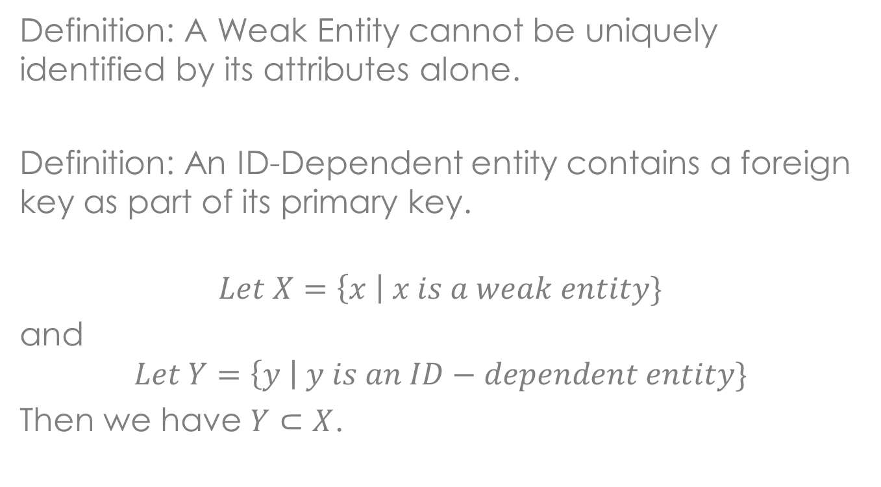
Definitions:
Definition: A Weak Entity cannot be uniquely identified by its attributes alone.
Definition: An ID-Dependent entity contains a foreign key as part of its primary key.
$$Let X=\left\{x \right| x is a weak entity\}$$
and
$$Let Y=\left\{y \right| y is an ID−dependent entity\}$$
Then we have $Y⊂X$.
Notes:
We’ll stick with ID-dependent entities in this presentation for simplicity. Let’s look at the quintessential ID-dependent relationship.

Slide 4
Quintessential Textbook
ID-Dependent/Weak Entities
Notes:
Point out the two relationships that are ID-Dependent and talk about the fact that Textbooks generally present this topic using designs similar to this ER-Diagram.
Is an intersection table
Is an association table because additional information is included.

Slide 5
ORM Intersection Tables
Database: ER-Diagram
Weak entity is not materialized by Entity Framework
Object: UML Design

Slide 6
ORM Association Tables

Slide 7

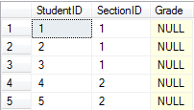


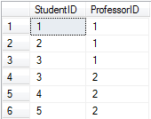
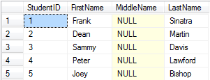
Demo Entity Framework with
Intersection & Association Tables
Professor
ClassRoster
Course Listing
ClassSection
StudentAdvisor
Student
Notes:
WHAT ARE WE GOING TO DO?
This is what we have,
This is what we will try to do.
First: We’ll take Dean Martin and Change His advisor from Nolan Ryan to Hank Aaron. From the database perspective this is easy. Just change the row (1,1) to (1,2). As we’ll see this is not how programmers view it with an ORM.

Slide 8
Textbook Demos

Slide 9
Association Table Pattern
Notes:
The association table pattern is really simple and it will work for both intersection and association tables.
Change the ID-Dependent entity into a weak entity that is not ID-Dependent.

Slide 10
Framework Demo

Slide 11
What’s the Big Deal?

Slide 12
public class VChinkStone : AbstractViewModel
{
private ARCH_Asc_ArchitecturalLocus_MasonryChinkStones _association;
public int StoneTypeID
{
get
{ return _association.StoneTypeID; }
set
{
ARCH_Asc_ArchitecturalLocus_MasonryChinkStones newAssociation =
new ARCH_Asc_ArchitecturalLocus_MasonryChinkStones();
newAssociation.ARCH_ArchitecturalLocusDescription = _association.ARCH_ArchitecturalLocusDescription;
newAssociation.StoneTypeID = value;
newAssociation.Percentage = _association.Percentage;
ARCH_Asc_ArchitecturalLocus_MasonryChinkStones oldAssociation = _association;
_association = newAssociation;
DB.context.ARCH_Asc_ArchitecturalLocus_MasonryChinkStones.DeleteObject(oldAssociation);
NotifyPropertyChanged("StoneTypeID");
}
} ...
public class VChinkStone : AbstractViewModel
{
private ARCH_Asc_ArchitecturalLocus_MasonryChinkStones _association;
public int StoneTypeID
{
get
{ return _association.StoneTypeID; }
set
{
_ssociation.StoneTypeID = value;
NotifyPropertyChanged("StoneTypeID");
}
} ...
Notes:
Of course the real difference happens in the ViewModel… This is an excerpt from our Archaeology program…
How long do you think it takes the average programmer to figure out what went wrong and how to fix it.
When estimates on the number of debugged lines of code that a programmer writes in an day range from 10-300, those six lines of code make the difference between a “Hacked” programmer, and a programmer that doesn’t have to “Hack a work-around.”

Slide 13
Questions
A zip with the code and SQL can be found at:
http://dra.cs.southern.edu/compwiki/
DatabaseManagementSystems/
AssociationTablePatern

